Slide 1
Technical Background of YOLO
삼김이최고 : D조

Slide 2
Introduction
Jongwoo Lee

Slide 3

What is YOLO?
YOLO – You Only Look Once
State-Of-The-Art Real-Time Object Detection
Single Neural Network
J. Redmon, S. Divvala, R. Girshick, and A. Farhadi,
“You Only Look Once: Unified, Real-Time Object Detection,”
2016 IEEE Conference on Computer Vision and Pattern Recognition
Notes:
Introduction: In recent years, computer vision has seen an immense amounts of advancements with the integration of deep learning. One of the most popular computer vision models used is the YOLO (You Only Look Once). YOLO is a SOTA real-time object detection system that detects objects in images or videos. The first version of YOLO, YOLOv1 was suggested in 2016. The latest version of the YOLO model is YOLOv8, which has built upon the shortcomings and errors experienced with its previous versions.

Slide 4
Pros
Speed – Fast Real-Time Processing
Accuracy - Unified Detection
Multiscale Detection
Notes:
Pros: One of the biggest pros of YOLO is its speed. It has real-time processing that makes it faster than other object detection systems, making it very useful in real-time applications such as video surveillance, robotics, and self-driving vehicles. Additionally, YOLO has a high degree of accuracy, and it can detect objects of various sizes, shapes, and colors without difficulty. Furthermore, it has a multi-scale detection feature that is able to recognize objects at different resolutions, making it more efficient than other models.

Slide 5
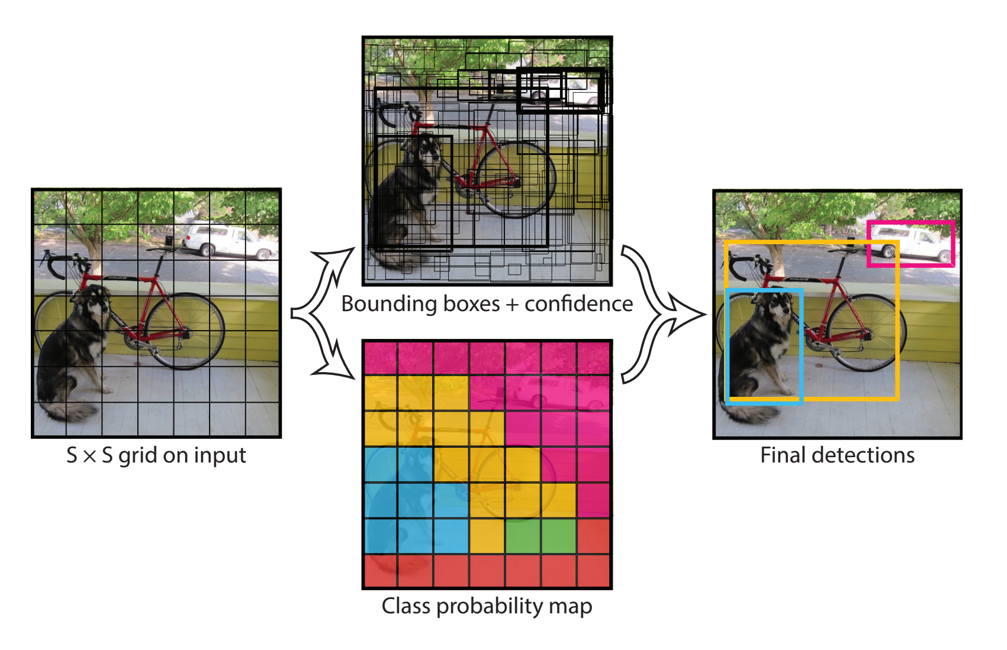
Unified Detection
Notes:
Yolo unify the separate components of object detection into a single neural network. The network uses features from the entire image to predict each bounding box. It also predicts all bounding boxes across all classes for an image simultaneously. This means that the network reasons globally about the full image and all the objects in the image.

Slide 6
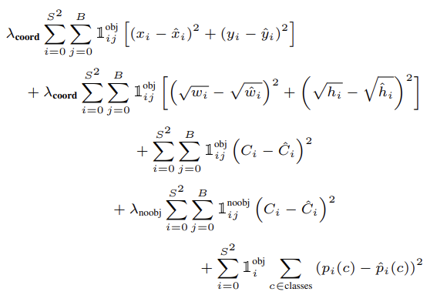
Loss Function
Notes:
This is loss function of Yolov1
1_ij^obj means 1 if there is an object in the j-th bounding box of the i-cell, 0 if there is no object
1_i^obj means 1 if there is an object in i-cell, 0 if there is no object in i-cell

Slide 7
 | Speed | Accuracy | Ease Of Implementation
Faster R-CNN | BAD | GOOD | BAD
SSD | GOOD | GOOD | BAD
YOLO | GOOD | GOOD | GOOD
Notes:
Comparison to other Technologies:
The YOLOv8 model is superior to other object detection models such as Faster R-CNN and SSD (Single Shot Detector) in terms of speed, accuracy, and object detection. Faster R-CNN is relatively slower, with fewer FPS (Frames per Second) than YOLO. In contrast, SSD has good speed but is substandard when it comes to the detection of small objects. YOLOv8 has addressed these shortcomings to provide a faster and more accurate object detection system.

Slide 8
Cons
Detect dense small objects
Affected by condition
Notes:
Cons: Despite its advantages, there are some limitations of the YOLO model. For instance, the model struggles to detect objects that partially occluded by other objects. Additionally, YOLO has poor performance in detecting smaller objects, and it is easily affected by changes in lighting conditions or blurriness. Lastly, it requires significant computational resources and powerful hardware processing to carry out its functionality.

Slide 9

Progress of YOLO
YOLOv1: Released in 2016, a deep learning-based network for real-time object detection
YOLOv2: Released in 2017, featuring improved performance and speed
YOLOv3: Released in 2018, improving both the accuracy and speed of object detection by improving network structure and learning methods
YOLOv4: Released in April 2020, and technologies such as SPP and PAN are applied to provide more accurate object detection and higher speed
YOLOv5: Released in June 2020 that improves object detection accuracy by more than 10% compared to YOLOv4, with faster speed
and smaller model size
YOLOv7: Released in July 2022, proposes an optimized module and an optimal technique, trainable bag-of-freibes, that strengthens the training cost by focusing on optimizing the training course
YOLOv6: Released in September 2022, using multiple methods to increase algorithm efficiency, especially by introducing some Quantization and distillation methods for mounting in the system
Notes:
YOLO progressed version v1 to v8. This is advance of YOLO. Improve performance, speed and accuracy. Also reduce the limitations by modify algorithm.

Slide 10
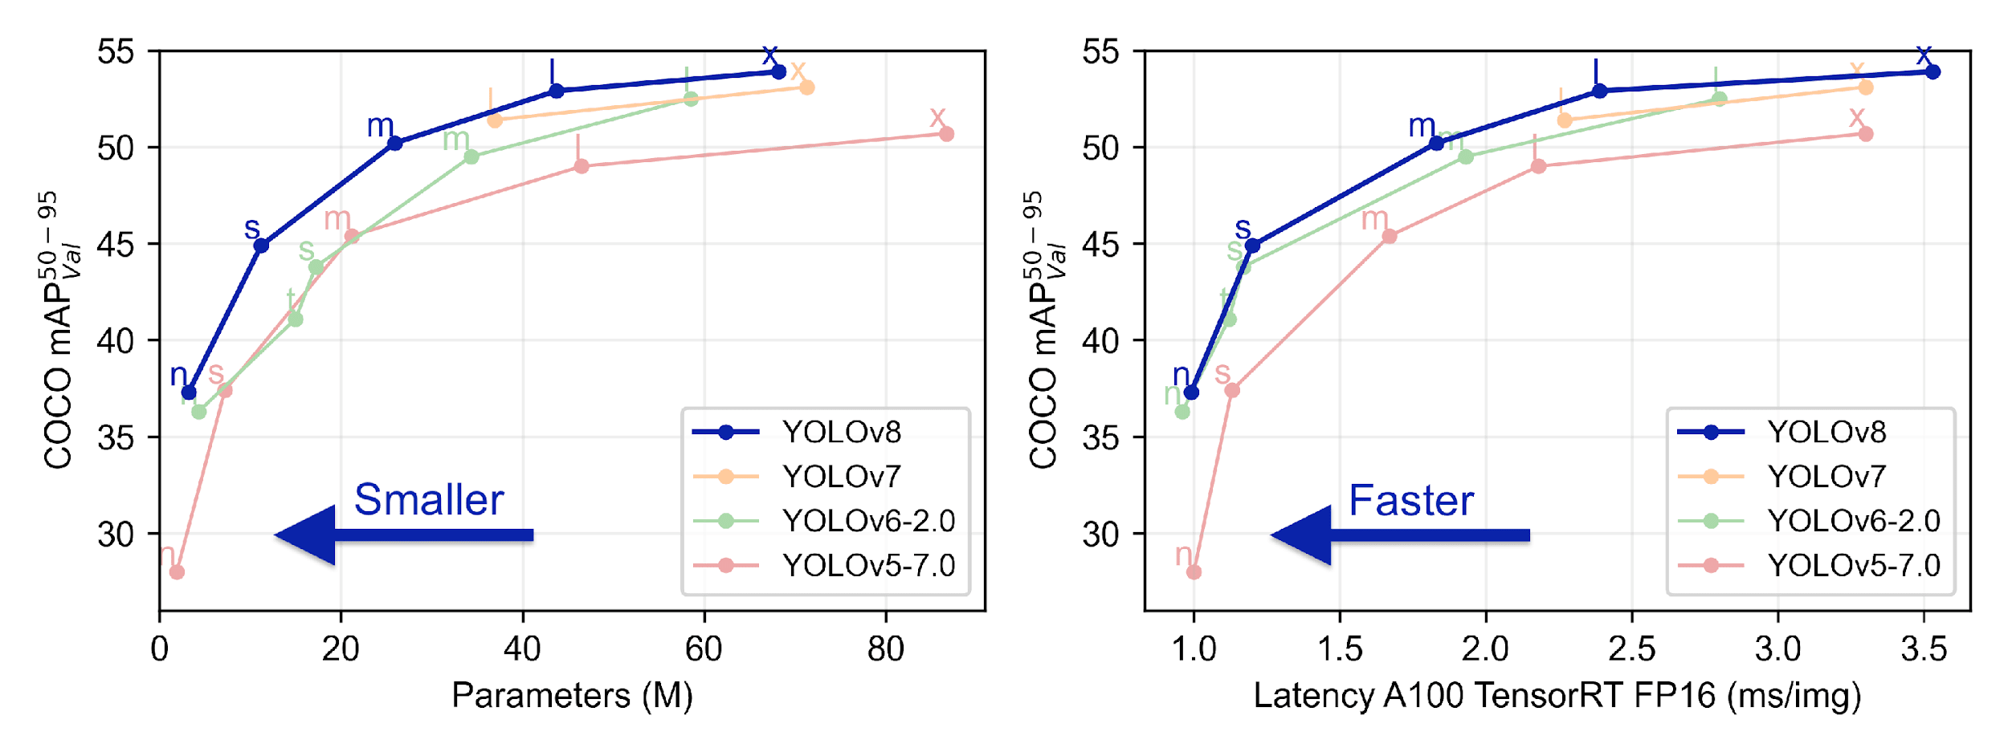
YOLOv8
Faster, Lighter, Smarter
Notes:
Conclusion: YOLOv8 is a significant innovation that is revolutionizing the computer vision field. Its speed, accuracy, and object detection capabilities make it unmatched in terms of real-time object detection. Although it has some limitations, it has addressed the shortcomings of other object detection systems like Faster R-CNN and SSD. It remains one of the most effective models of computer vision, and its potential for many applications is immeasurable.

Slide 11
Architecture
Yongtaek Kim

Slide 12
YOLOv8 Architecture ▶ Deep Dive
Anchor Free Detection
New Convolutions
Using the Mosaic Augmentation

Slide 13
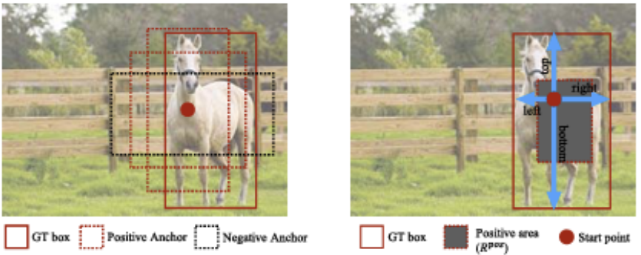
YOLOv8 Architecture ▶ Anchor Free Detection
< Using Anchor Box>
< Anchor Free >
Flexible and Efficient depending on the situation
→ NMS(Non-Maximum Supression) Processing Speed ↑

Slide 14
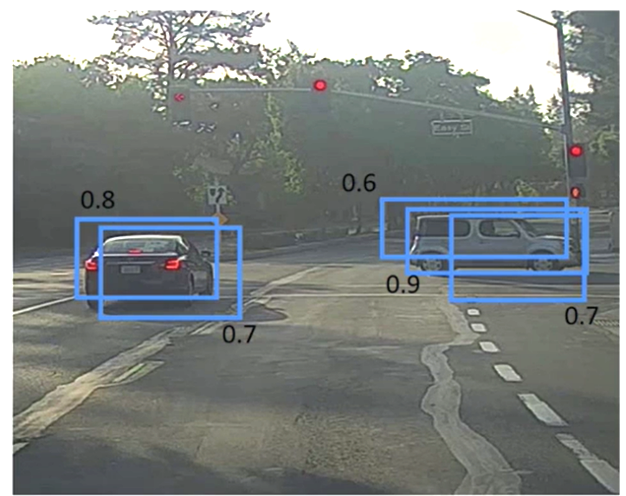
Anchor Free Detection ▶ NMS(Non-Maximum Supression)
Reduce the Number
of Box Predictions
↓
Processing Speed ↑
of Candidates Screening after Calculate of Probability

Slide 15
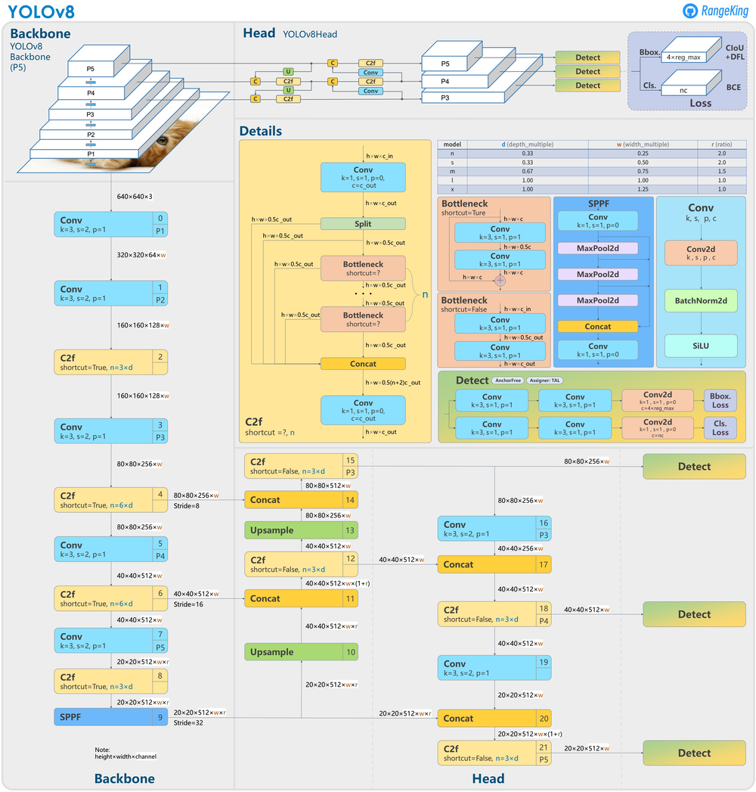
YOLOv8 Architecture ▶ New Convolutions
New Backbone Network
→ Darknet-53
More Efficient Convolutional Neural Network
Larger Feature Map
↓
Detect objects more accurate and faster
Capture More Complex Relationships
Better Recognize Patterns and Objects
Reduce the Amount of Time for Training
Reduce Overfitting.

Slide 16
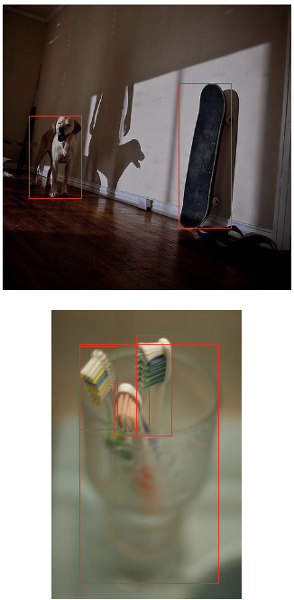
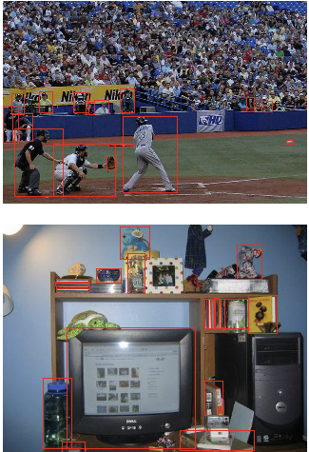
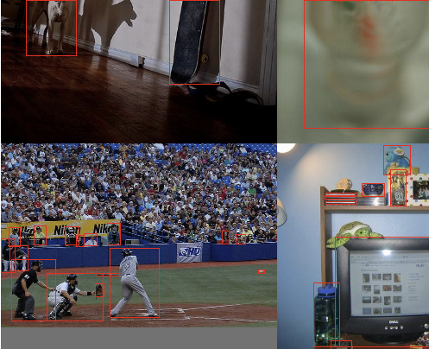
YOLOv8 Architecture ▶ Mosaic Augmentation
Combine
Randomly

Slide 17
YOLOv8 Architecture ▶ Mosaic Augmentation
Make Images & Objects Smaller
↓
Help to Overcome YOLO’s Shortcoming
→ Difficult to Detect Small Objects
Effect of learning Four Images with One Image
→ It makes Easy to learn with Small Batch size

Slide 18
Tasks and Modes
Nayoung Choi
Notes:
Hi, I'm Choi Nayoung.
Now I will explain the tasks and modes provided by yolo.

Slide 19
3 Tasks of YOLO
Classify
Detect
Segment
Notes:
First of all, I will explain the tasks provided by YOLO, which are classify, detect, and segment.

Slide 20

Image Classification ??
Object Detection ??
Image Segmentation ??
Notes:
In the computer vision field,
one of the most common doubt which most of us have is /
what is the difference between image classification, object detection and image segmentation.
When preparing this presentation, I was also confused with these terms.
So, I decided to break down these terminologies
which will help you to understand the difference between each of them.

Slide 21
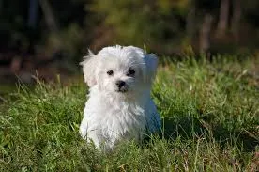
Classify
Notes:
Let’s start with understanding what is image classification:
Look at the image on the screen:
You will have instantly recognized it. It’s a dog. Take a step back and analyze how you came to this conclusion. You were shown an image and you classified the class it belonged to.
And that, in a nutshell, is what Image Classification is all about.
As you saw, there’s only one object here: a dog. We can easily use image classification model and predict that there’s a dog in the given image.

Slide 22
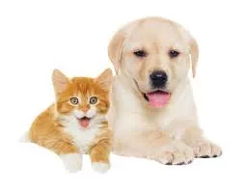
Classify
Notes:
But what if we have both a cat and a dog in a single image?
We can train a multi-label classifier, in that instance.
Now, there’s another problem that we won’t know the location of either animal/object in the image.

Slide 23
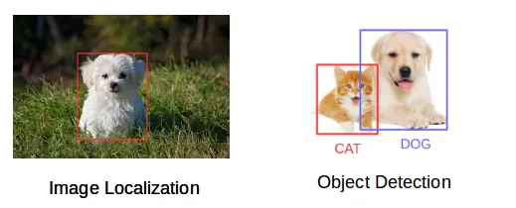
Object Detection
Notes:
So the concept we need is image localization.
It helps us to identify the location of a single object in the given image.
In case we have multiple objects present, we then rely on the concept of Object Detection.
We can predict the location along with the class for each object using OD.

Slide 24
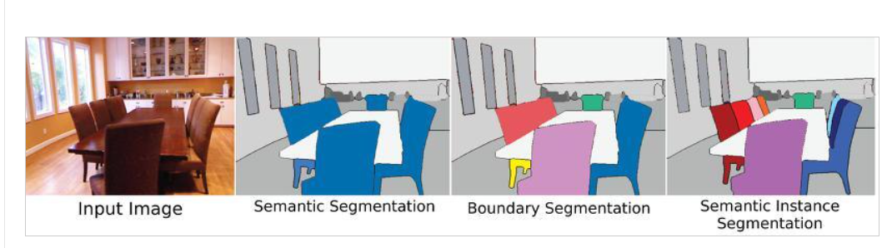
Segment
Notes:
Before detecting the objects and even before classifying the image, we need to understand what the image consists of. This is where Image Segmentation is helpful.
We can divide or partition the image into various parts called segments. It’s not a great idea to process the entire image at the same time as there will be regions in the image which do not contain any information.
By dividing the image into segments, we can make use of the important segments for processing the image. That is how Image Segmentation works.

Slide 25
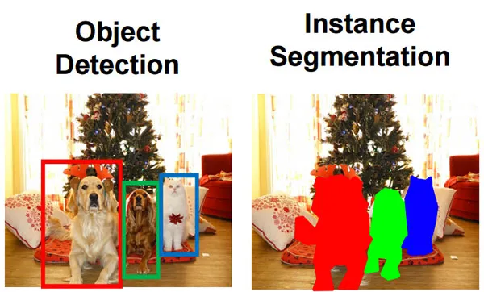
Segment
Notes:
By applying Object Detection models, we will only be able to build a bounding box corresponding to each class in the image. But it will not tell anything about the shape of the object as the bounding boxes are either rectangular or square in shape.
Image Segmentation models on the other hand will create a pixel-wise mask for each object in the image. This technique gives us a far more granular understanding of the object in the image.
I hope you now have a clear understanding of what is Image Classification, Image Localization, Object Detection and Image Segmentation.

Slide 26
Models of YOLO
Train
Val
Predict
Export
Track
BenchMark
Notes:
From now on, I would like to talk about various models supported by yolo's tasks.
Types of models include train, val, predict, export, track, benchmark, etc

Slide 27
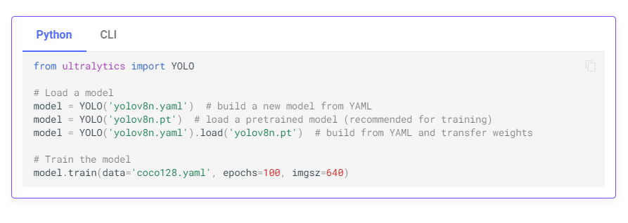
Train
Notes:
Train mode is used for training a YOLOv8 model on a custom dataset.
In this mode, the model is trained using the specified dataset and hyperparameters.
The training process involves optimizing the model's parameters so that it can accurately predict the classes and locations of objects in an image.

Slide 28
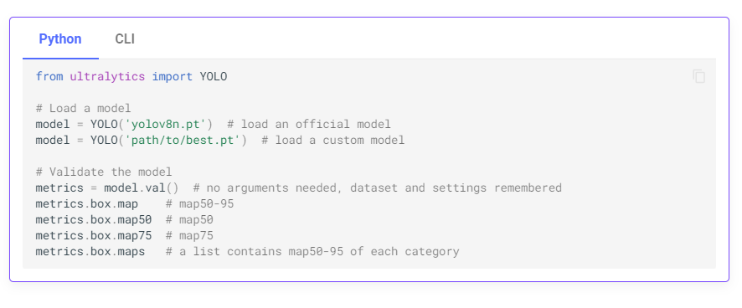
Val
Notes:
Val mode is used for validating a YOLOv8 model after it has been trained.
In this mode, the model is evaluated on a validation set to measure its accuracy and generalization performance.
This mode can be used to tune the hyperparameters of the model to improve its performance.

Slide 29
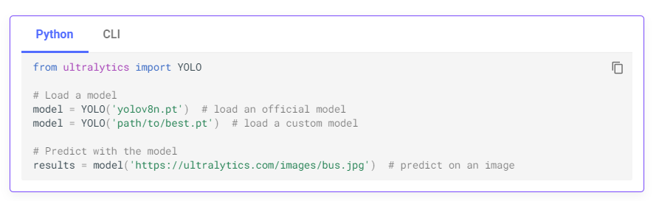
Predict
Notes:
And you can use the trained model to predict the image or video.

Slide 30
BIG NEWS
Tracking model is updated to YOLO!!
Notes:
And lastly, I would like to explain the tracking model.
In fact, this is really big news.
yolo was actually a deep learning method that was recognized for its best performance in computer vision.
In addition, the tracking model function was updated not too long ago,
so I think more people will use yolo in the future.

Slide 31
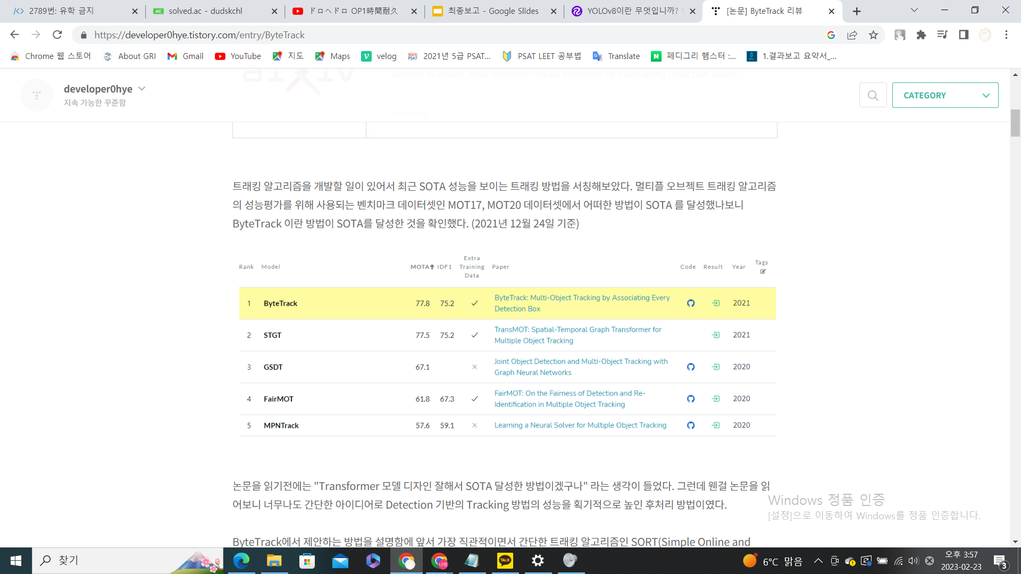
previous tracking tool
MOT17, MOT20 데이터셋에서 SOTA 달성 (2021년 기준)
MOT : multiple object tracking algorithm performance benchmark
Notes:
previously, we had to download another tracking tool and learn how to operate it.
The most popular models were the ByteTrack, Sort, or DeepSort models.

Slide 32
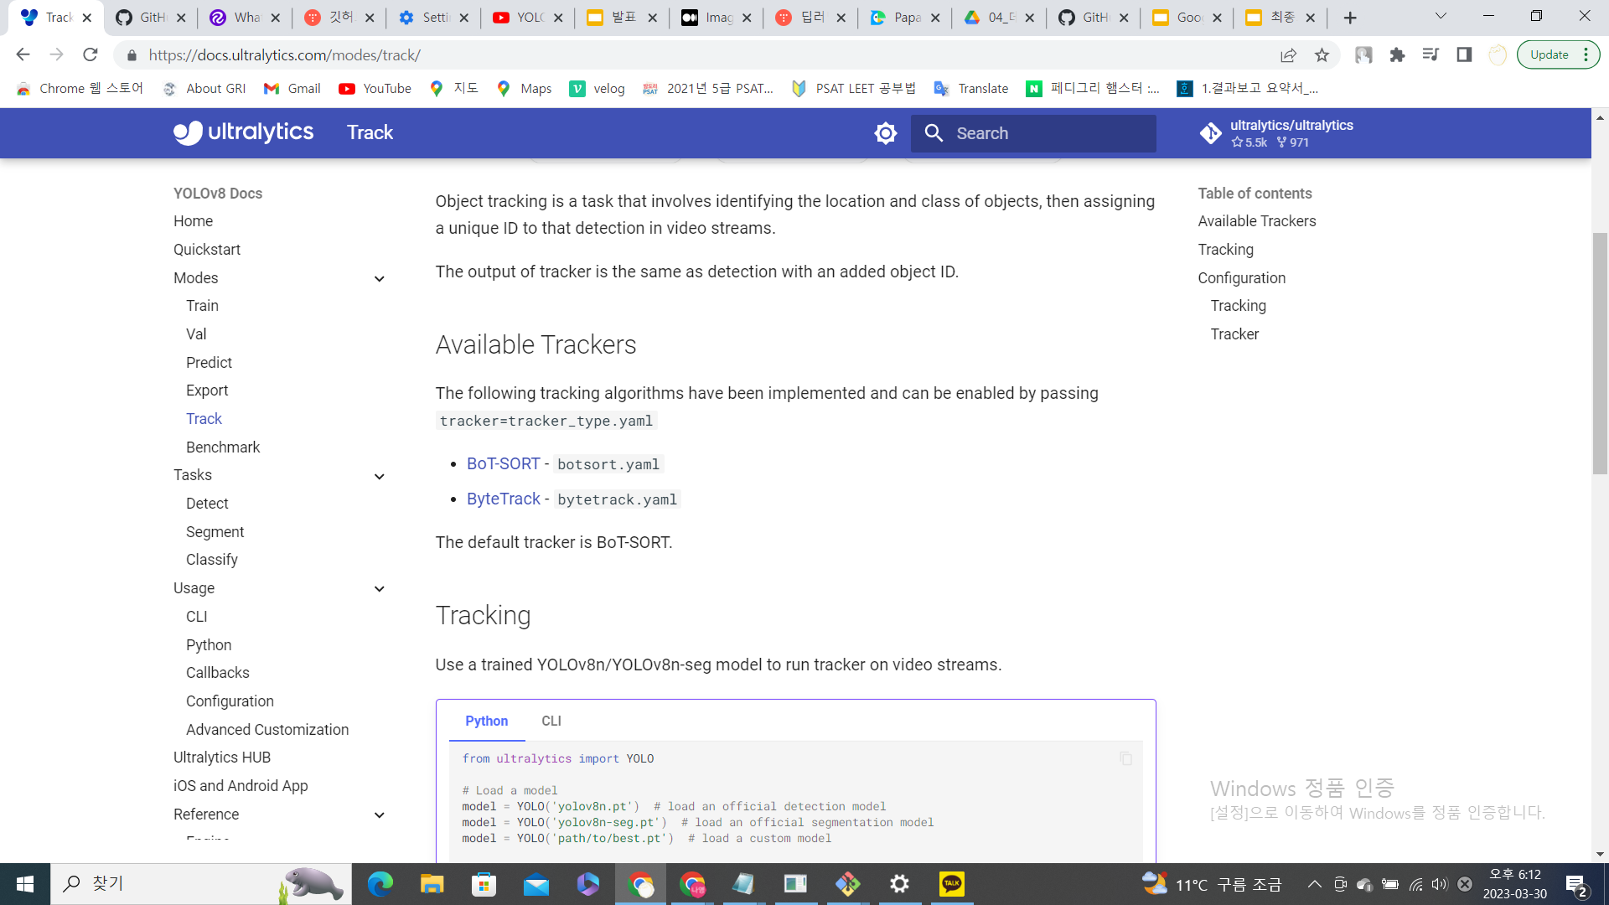
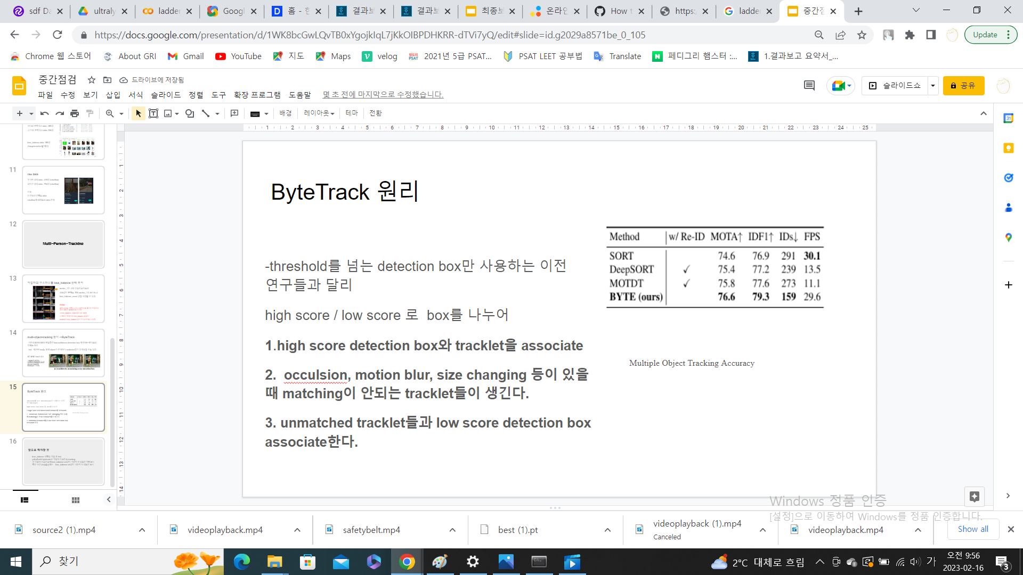
YOLO + Tracking model
Notes:
Now that YOLO itself supports the tracking model, you can use the tracking system more conveniently in the future.
The tracking models currently supported by YOLO are BOT-sort and ByteTrack.
Personally, byteTrack is a preferred method because there are fewer id switches,
For now, the default of yolo setting is bot-sort method.

Slide 33
Video
Notes:
Tracking systems are required primarily when we have multiple objects of the same class and we need to separate each instance.
This is a video that I used bytetrack to track people instances, in which case I can track each person's behavior.
And now, it is possible to implement a track system like this video using only yolo.
let’s watch another video.
As you can see, we can track the instance by using only yolov8.
So far, this is the end of the presentation.
Thank you for your attention.

